Slide 1
AI STUDENT RIGHTS
AI and Your Education
What you have a right to know
When AI is used in teaching, assessment, advising, or student services, students should be able to understand how it is being used and how it may affect them.
👁
KNOW
U
UNDERSTAND
when AI is being used and how it may affect feedback, grading, advising, or decisions
how your personal information, coursework, and intellectual property are protected
H
REQUEST HUMAN REVIEW
Q
QUESTION OR APPEAL
of consequential academic decisions influenced by AI
a decision when AI may have contributed to the outcome
A
ACCESS AN ALTERNATIVE
S
EXPECT CLEAR STANDARDS
when a required tool creates an accessibility, privacy, cost, or technology barrier
for how your work will be evaluated
Consult our policies for specific rights and procedures.
AI should support learning while preserving transparency, privacy, fairness, accessibility, and human judgment.
Customize this poster with your institution’s AI policy, student support resources, and review procedures.
INSTITUTION
LOGO
Institution AI policy and support
QR
Add policy URL or QR code • Office/contact • Accessibility support

Slide 2
ACADEMIC INTEGRITY + AI
Before You Use AI
Pause. Check. Disclose.
Responsible AI use begins before the work is submitted. Students should verify expectations, protect information, and disclose AI assistance when required.
1
PAUSE
Will AI support your learning, or replace work you are expected to do?
2
CHECK
Review the syllabus, assignment instructions, instructor guidance, and institutional policy.
3
DISCLOSE
Acknowledge AI assistance when required. Be ready to explain what you used and how.
Appropriate when permitted
Potential integrity violations
• Brainstorming topics or questions
• Explaining difficult concepts
• Practicing with sample questions
• Improving organization or clarity
• Getting feedback on your original draft
• Submitting AI-generated work as your own
• Using AI during a prohibited assessment
• Inventing quotations, citations, data, or evidence
• Uploading protected or personal information
• Skipping required analysis or original thinking
When instructions are unclear, ask before submitting the work.
Add local examples here: approved AI tools, disclosure language, academic integrity policy, and the appropriate office/contact.
INSTITUTION
LOGO
Institution AI policy and support
QR
Add policy URL or QR code • Office/contact • Accessibility support

Slide 3
YOUR WORK. YOUR RESPONSIBILITY.
AI Can Assist Your Work.
It cannot take responsibility for it.
Before submitting AI-assisted work, check every part of the final product.
✓
ACCURATE?
✓
PERMITTED?
Verify facts, calculations, quotations, and claims.
Follow the rules for this course and assignment.
✓
REAL SOURCES?
✓
YOURS?
Locate and read every source before citing it.
Make sure the final work reflects your understanding, judgment, and voice.
✓
FAIR?
✓
EXPLAINABLE?
Check for stereotypes, exclusions, and biased assumptions.
Be able to defend the reasoning, methods, and conclusions you submit.
✓
PRIVATE?
✓
DISCLOSED?
Do not upload protected student, research, employee, or institutional information.
Identify AI assistance when required.
YOU
remain responsible
Your name is on the work. The responsibility is yours.
Use AI to support thinking, not to replace it. Verify, revise, and be ready to explain what you submit.
INSTITUTION
LOGO
Institution AI policy and support
QR
Add policy URL or QR code • Office/contact • Accessibility support

Slide 4
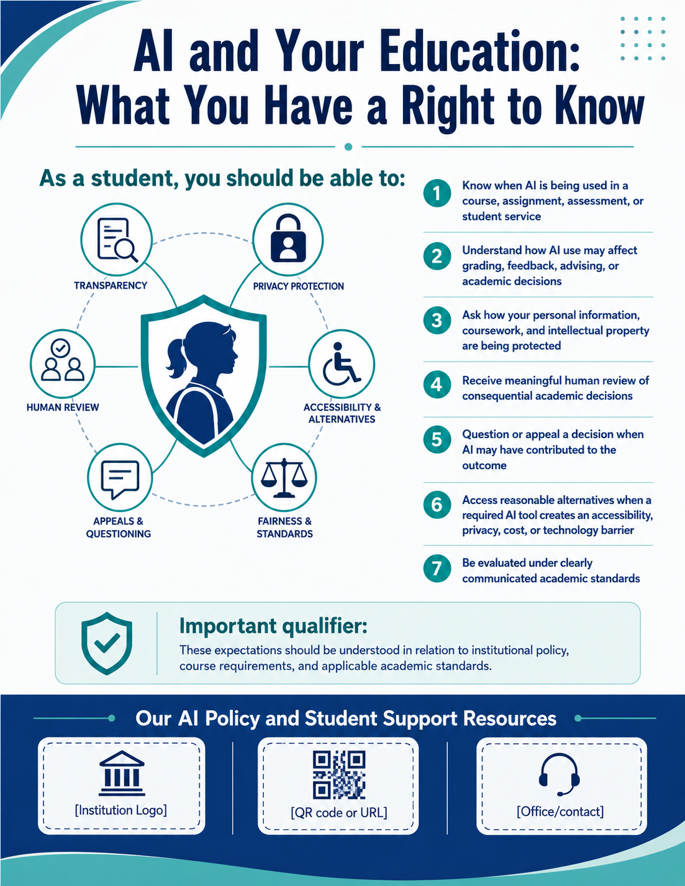

Slide 5
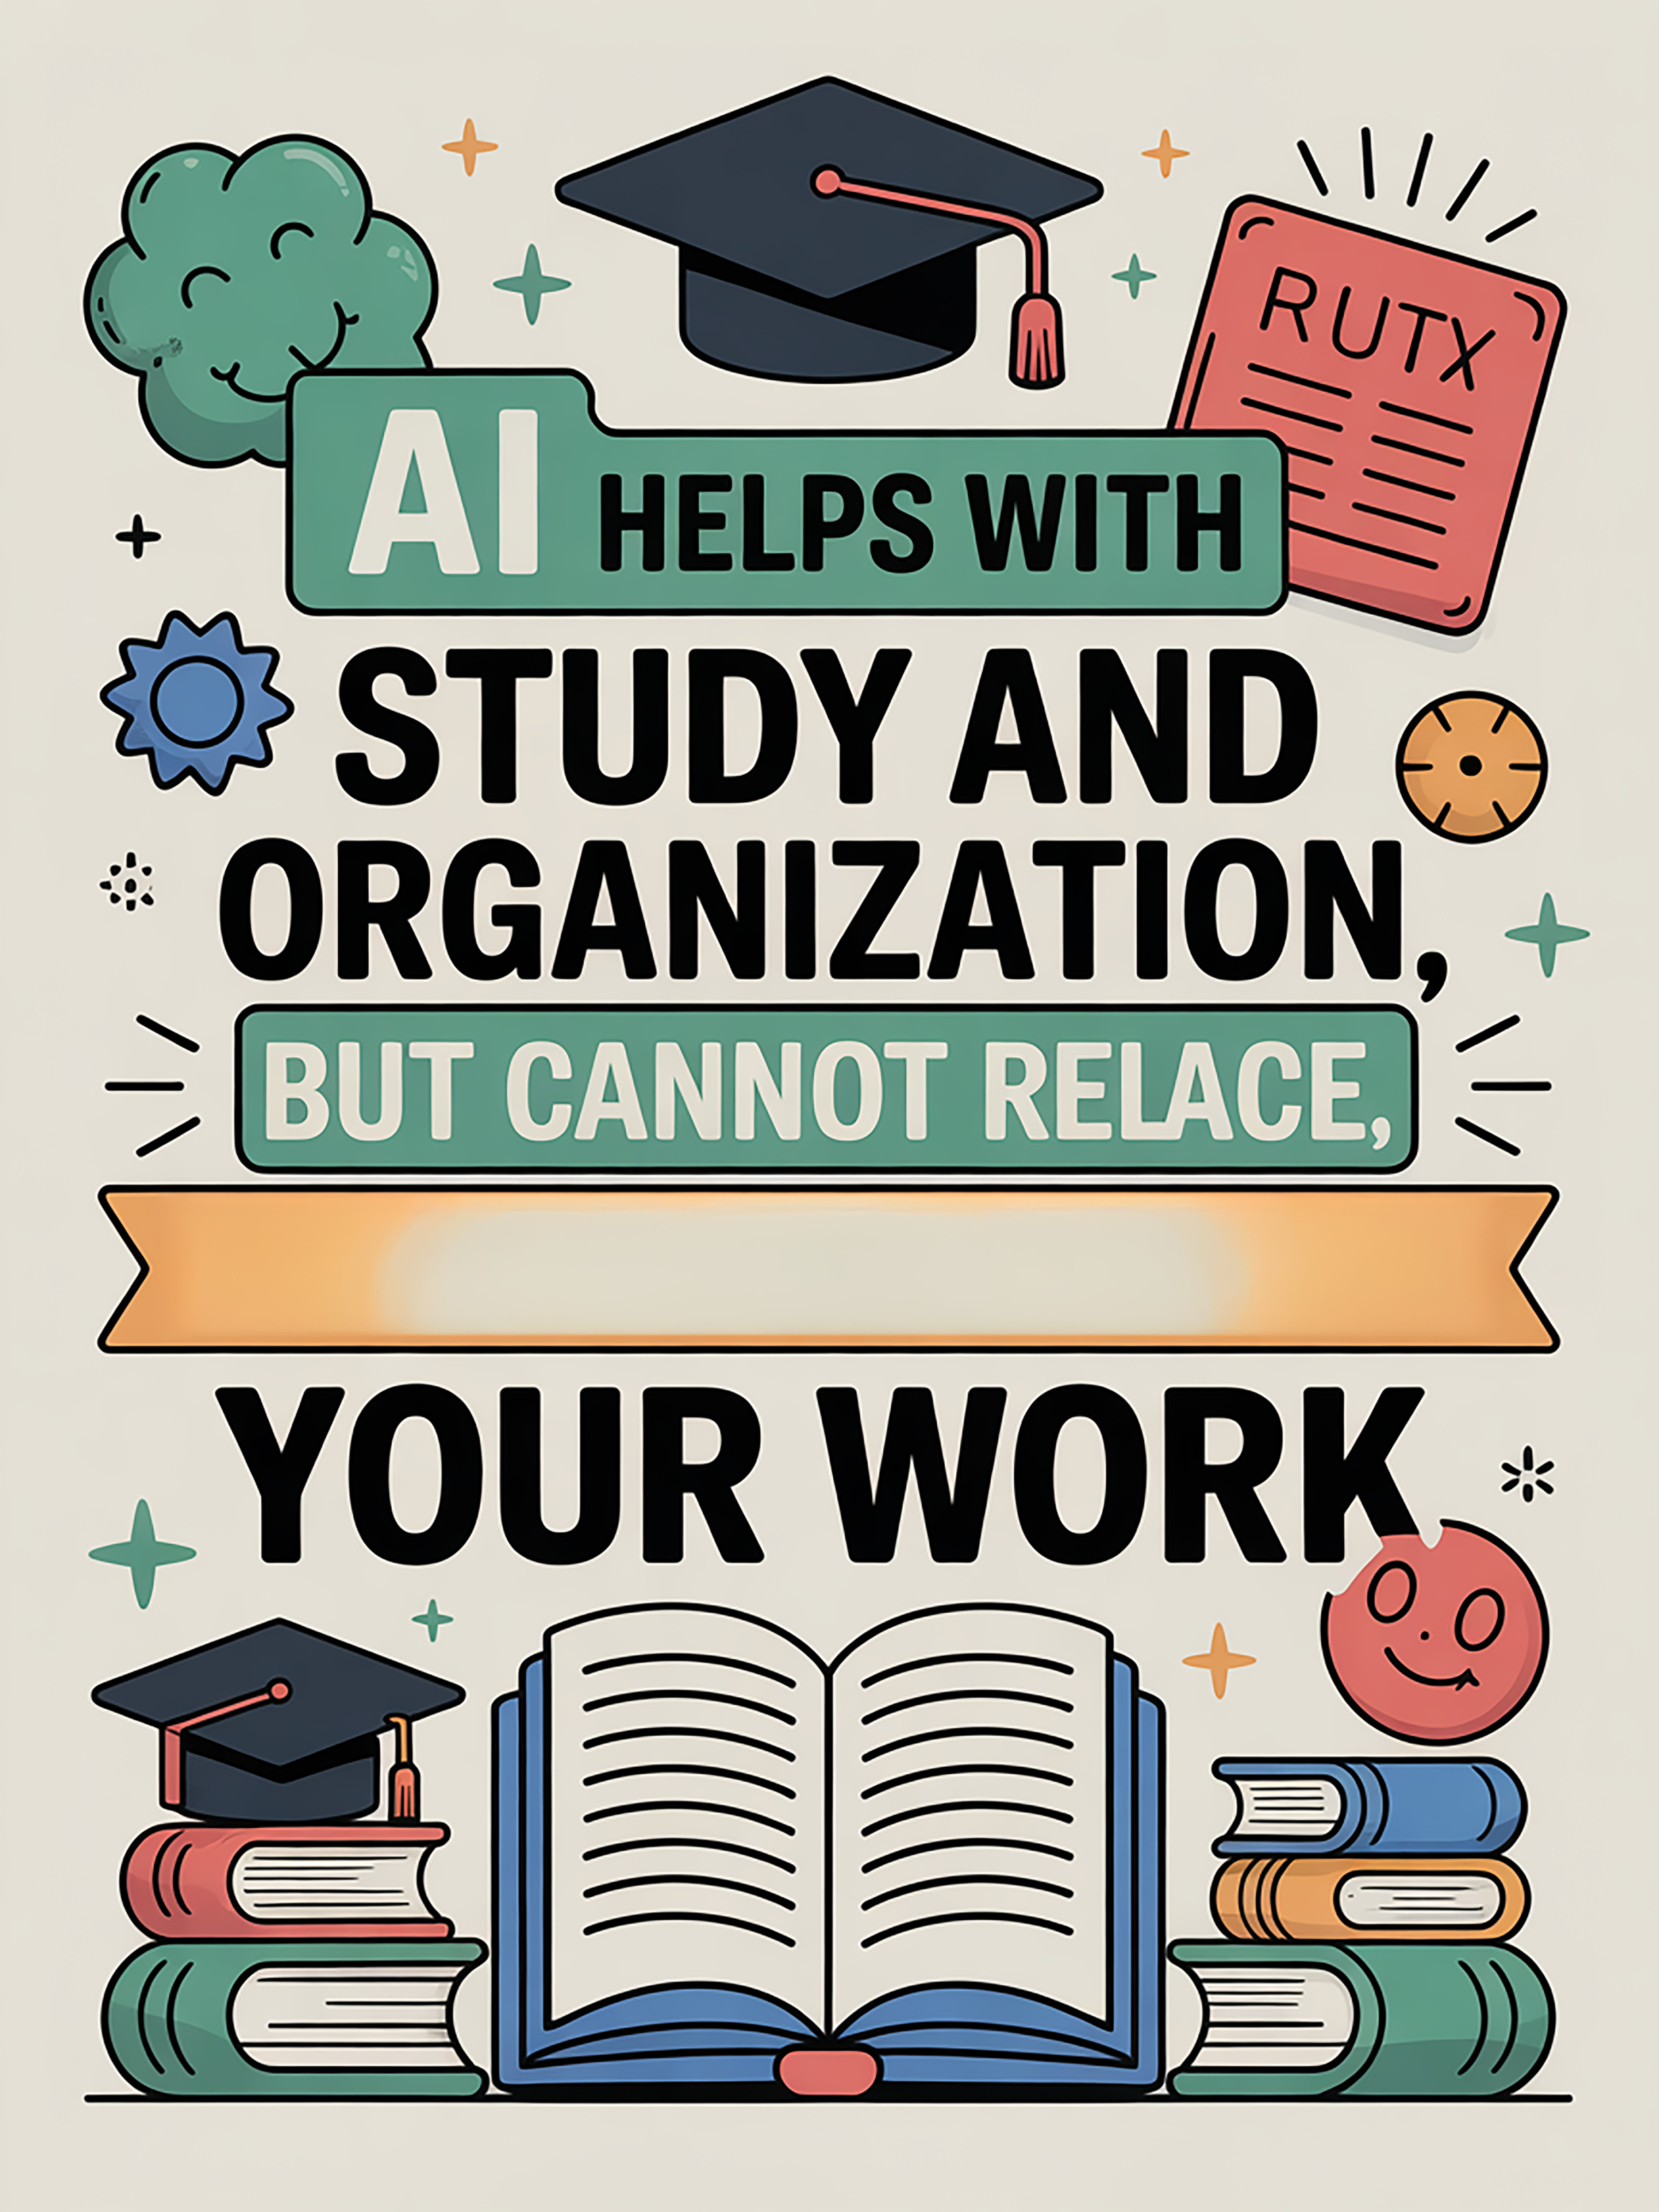
INSTITUTION
LOGO
Institution AI policy and support
QR
Add policy URL or QR code • Office/contact • Accessibility support

Slide 6
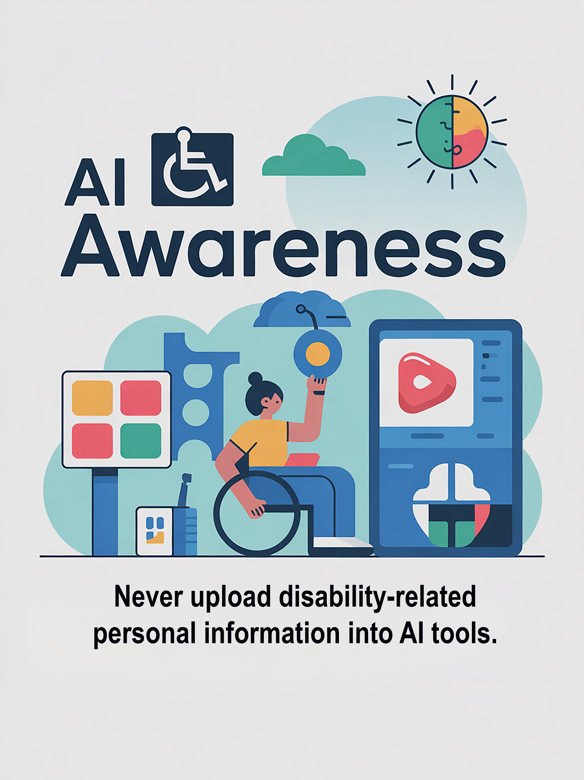
INSTITUTION
LOGO
Institution AI policy and support
QR
Add policy URL or QR code • Office/contact • Accessibility support

Slide 7
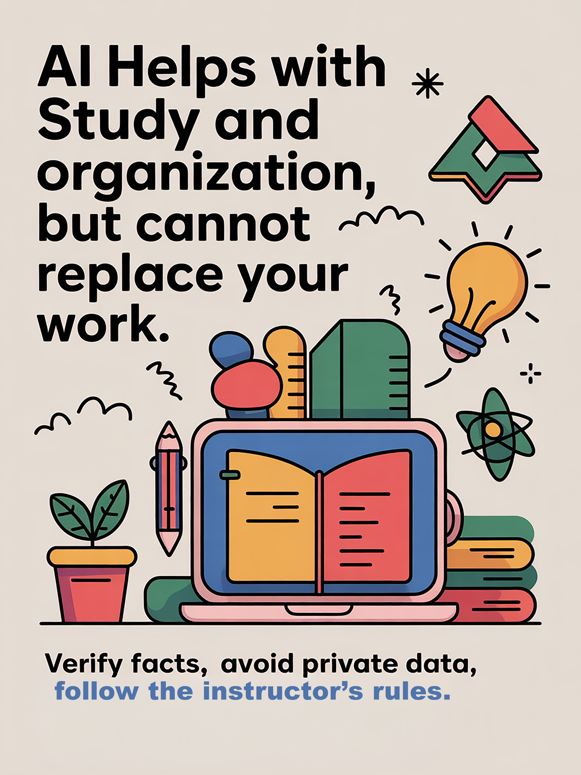
INSTITUTION
LOGO
Institution AI policy and support
QR
Add policy URL or QR code • Office/contact • Accessibility support

